Slide 1
Primary Colours

Slide 2
We can use these to mix any colour

Slide 3
Primary colours make a colour wheel – Yellow up

Slide 4
Secondary Colours

Slide 5
Light

Slide 6
Brighter

Slide 7
Darker

Slide 8
Tonal Range

Slide 9
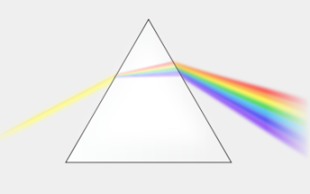
White light consists of all colours

Slide 10
What about Black and White?
?
?

Slide 11
White Reflects, Black Absorbs

Slide 12
Mixing Black

Slide 13
Illusion of 3D

Slide 14
Illusion of 3D

Slide 15
Base, Highlight and Shadow
Base

Slide 16
Base, Highlight and Shadow

Slide 17
Base, Highlight and Shadow

Slide 18
Mixing our colours

Slide 19
Mixing our colours

Slide 20
Mixing our colours
Lighten
Darken
Brighten

Slide 21
Shadows

Slide 22
Shadows

Slide 23
Shadows

Slide 24
Highlights

Slide 25
Highlights

Slide 26
Highlights

Slide 27
Base, Highlight and Shadow
Base
Highlight
Shadow

